Slide 1
Portuguese HF Radar Network: Security applications
CFR EH Carlos S. Fernandes

Slide 2
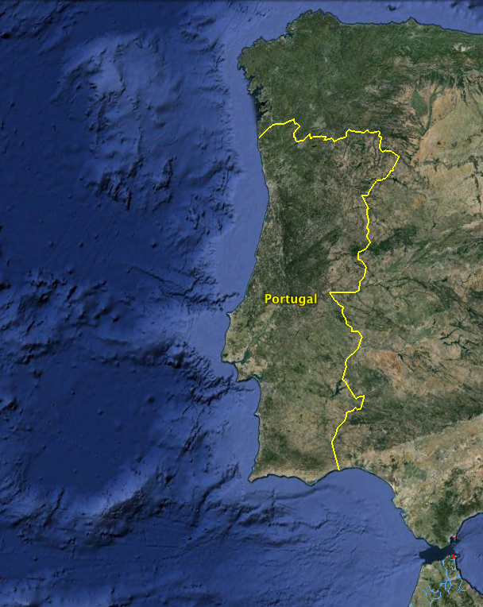
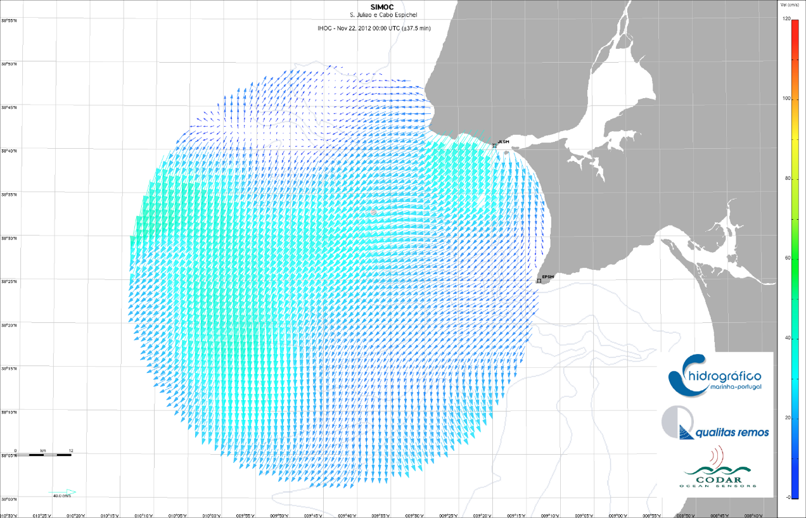
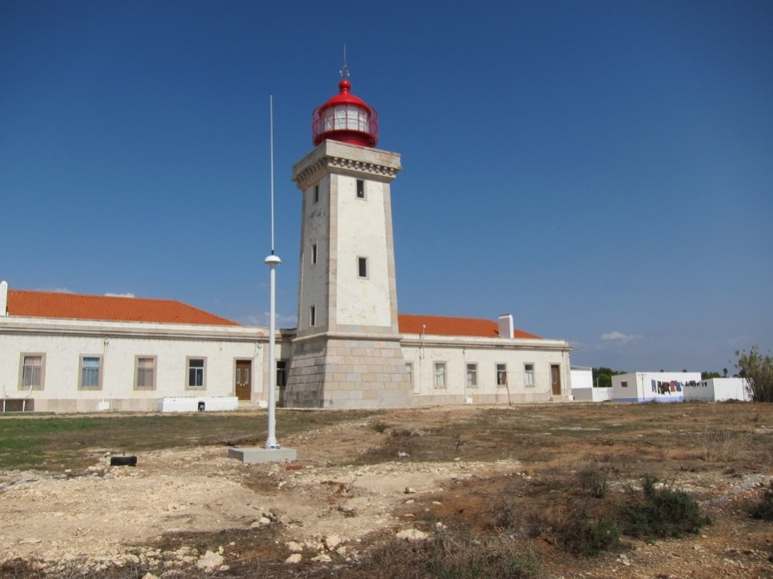
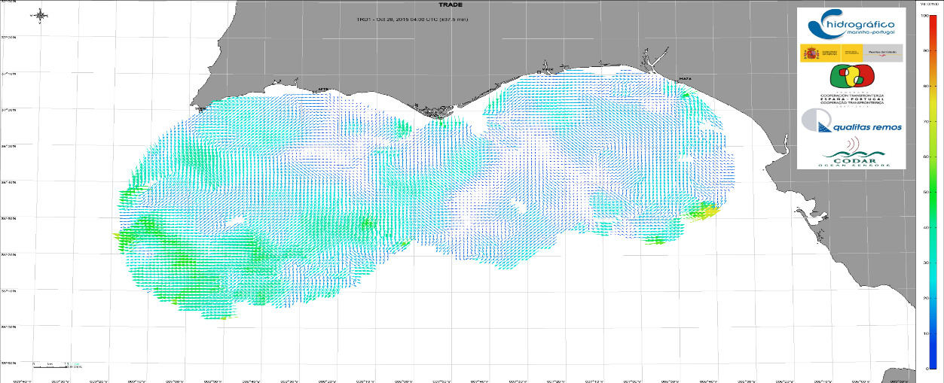
PORTUGUESE OCEANOGRAFIC OBSERVATION NETWORK
HF Radar Network
HF stations – Algarve (2012-2015 )

Slide 3
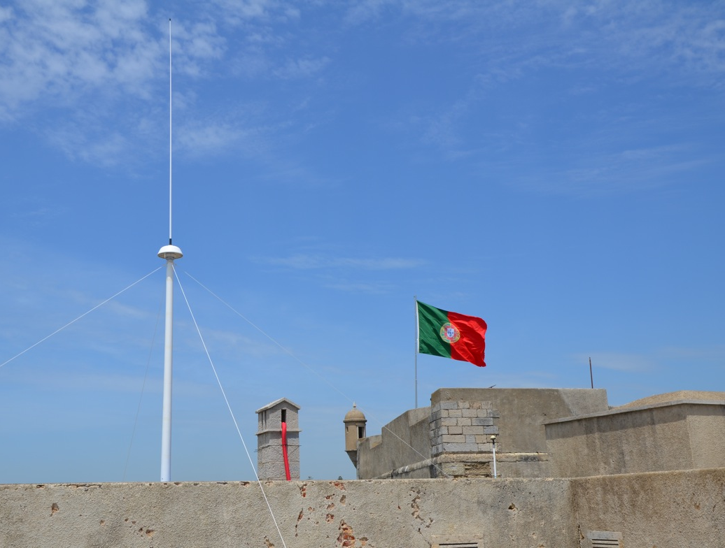
PORTUGUESE OCEANOGRAFIC OBSERVATION NETWORK
HF Radar Network
HF station – S. Julião fortress
(operacional since 2012 )

Slide 4
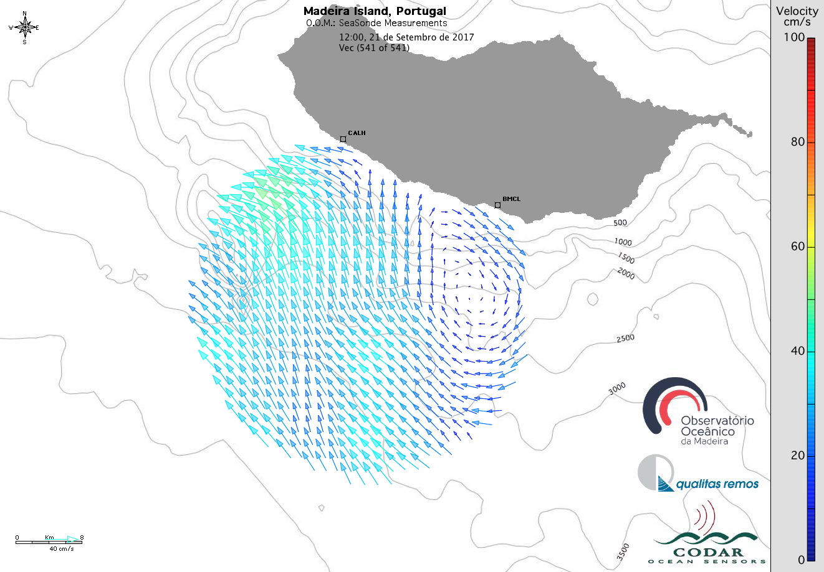
PORTUGUESE OCEANOGRAFIC OBSERVATION NETWORK
HF Radar Network
OBSERVATÓRIO OCEANOGRÁFICO DA MADEIRA

Slide 5
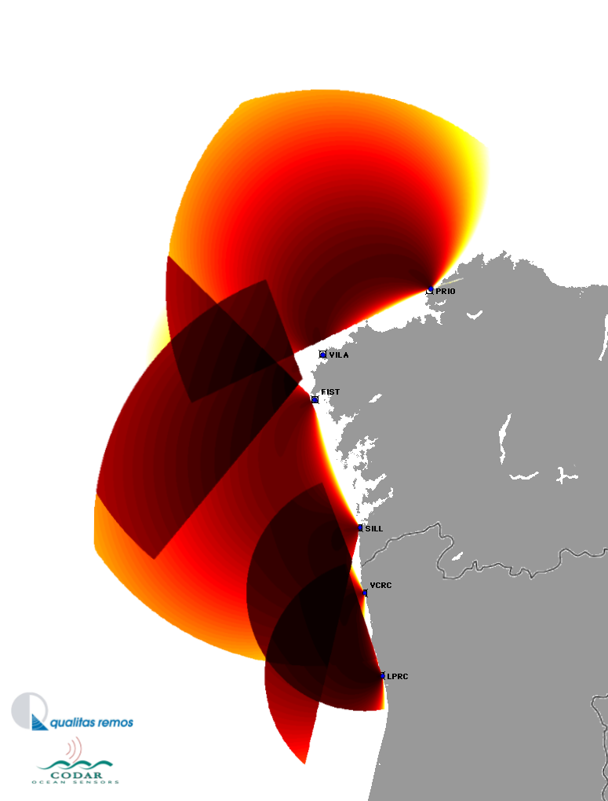
Project to be submitted
RADAR ON RAIA – Radares no Observatório do Norte RAIA
Gold: Reinforce investigation, develop technology and innovation; Improve scientific excellency on the Iberian space.
Period: 2018 – 31/12/2020
TASK: (1) Develop and reinforce the present cross-border observation HF Radar network with two more stations.
Funding: POCTEP
5
Notes:
5

Slide 6
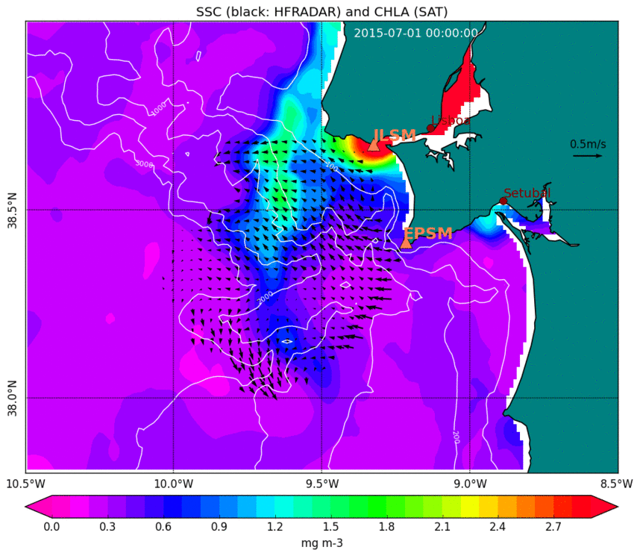
Project to be submitted
HFISH – HF Fish Management
Gold: Correlate chlorophyll (SAT DATA) convergence patterns and surface currents (Radar HF DATA) with population densities of sardines and mackerel.
Satus: Under Development
Partners: IPMA, DGRM, UCOIMBRA, UAVEIRO, QUALITAS, CCDR-CENTRO
Collaboration from RUTGERS (Josh Kohut)
Notes:
6

Slide 7
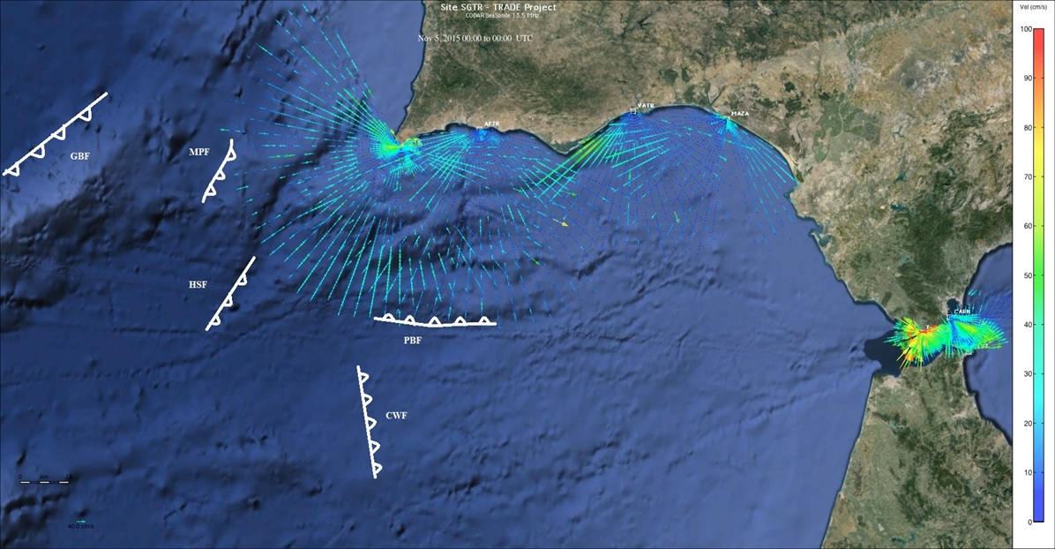
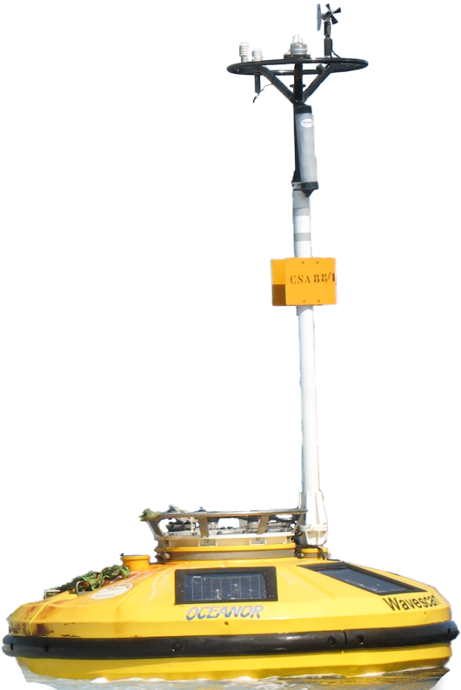
On going project
OCASO – Observatório Costeiro Ambiental do SudOeste
From: Fernandes, M. (2015). Workshop Marine Technologies, Hydrographic Institute – Courtesy of QUALITAS.
Period: 14/06/2017 – 31/12/2019
TASK: (1) ADCP Long Range on the Faro WAVESCAN buoy; (2) Bottom pressure sensors by the same buoy; (3) Installation of a CODAR Tsunami Detection Software Package (SSDA-TSUN) on the Sagres HF Radar station.
Funding: POCTEP – 1 750 000.00€
7
Notes:
7

Slide 8
OPERATIONAL
APLICATIONS

Slide 9
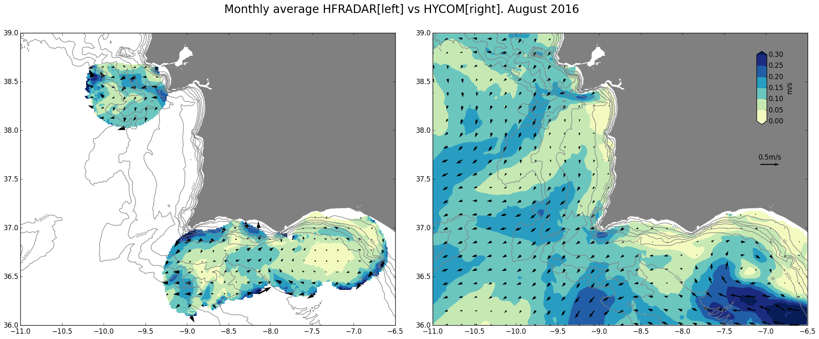
MODEL Validation - HYCOM
Notes:
9

Slide 10
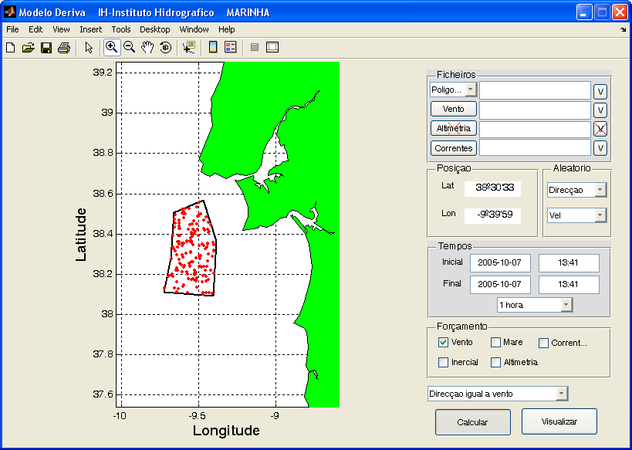
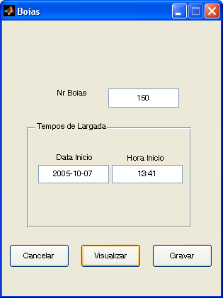
SAR operations and MASS Rescue

Slide 11
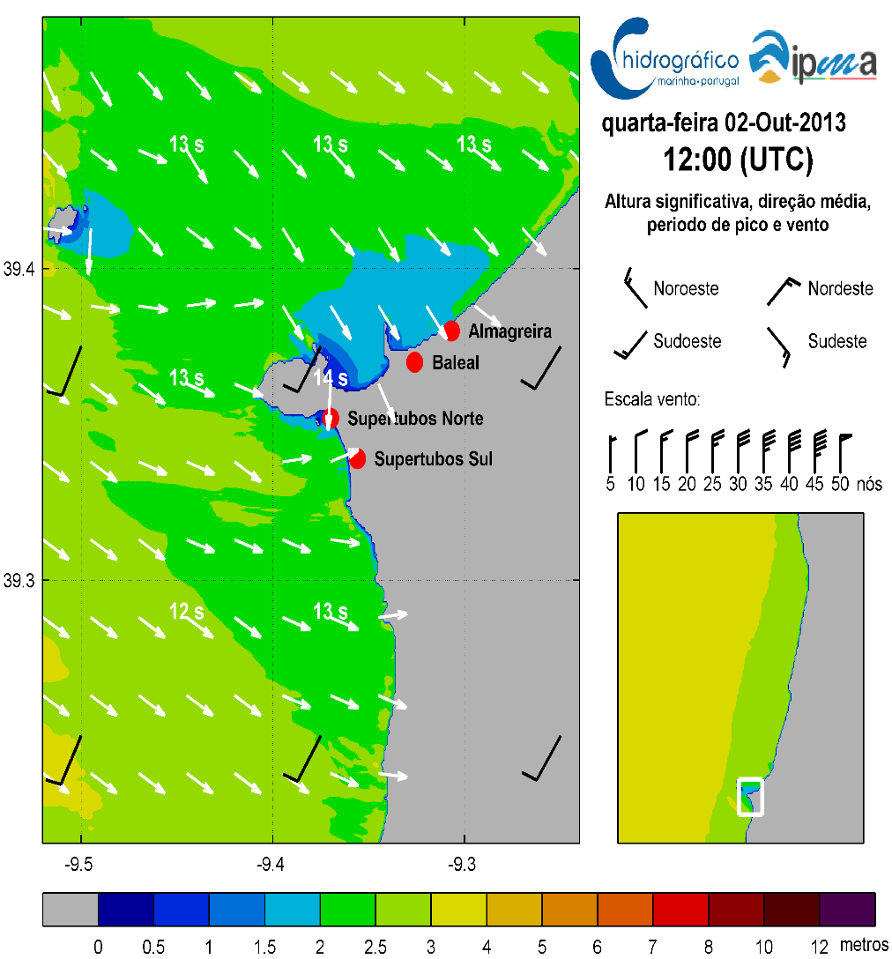
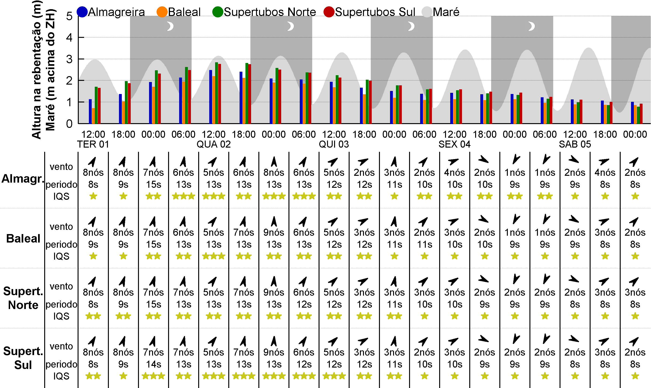
Surf Conditions Forecast
http://www.hidrografico.pt/qual-e-a-tua-onda.php

Slide 12
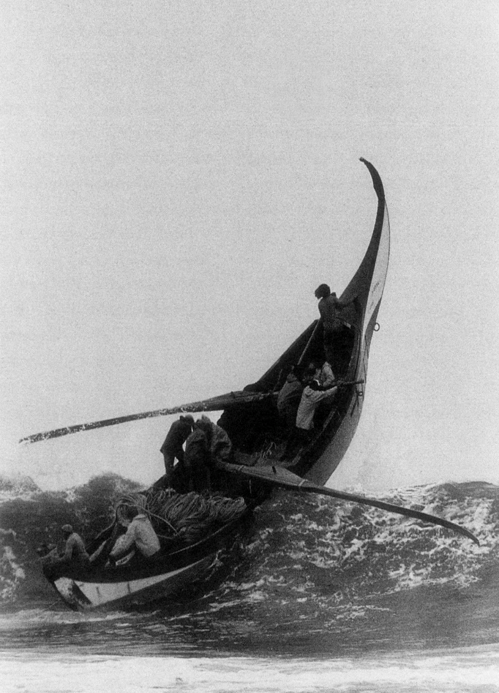
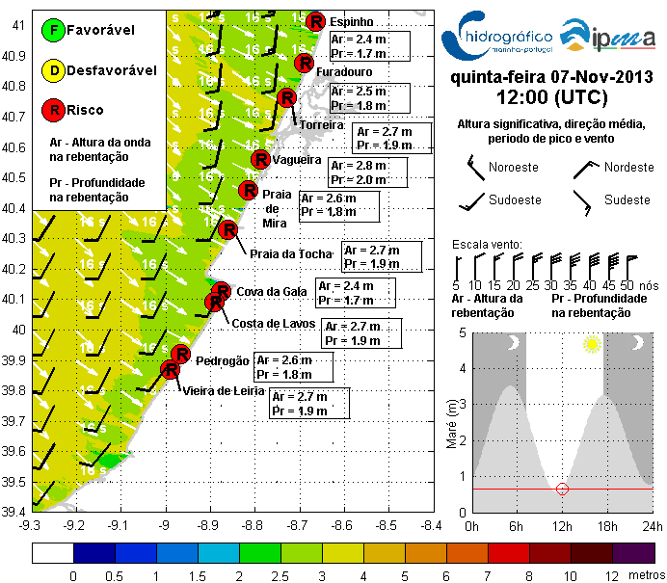
Fishery Activities

Slide 13
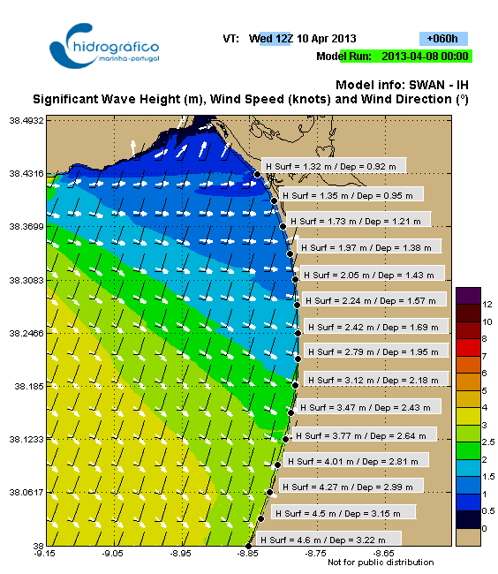
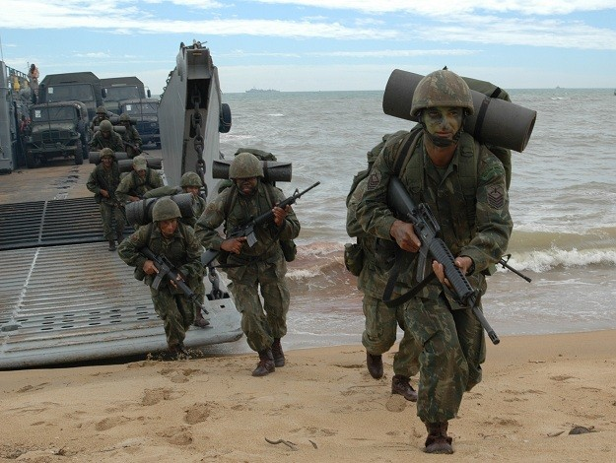
Amphibious Operations

Slide 14
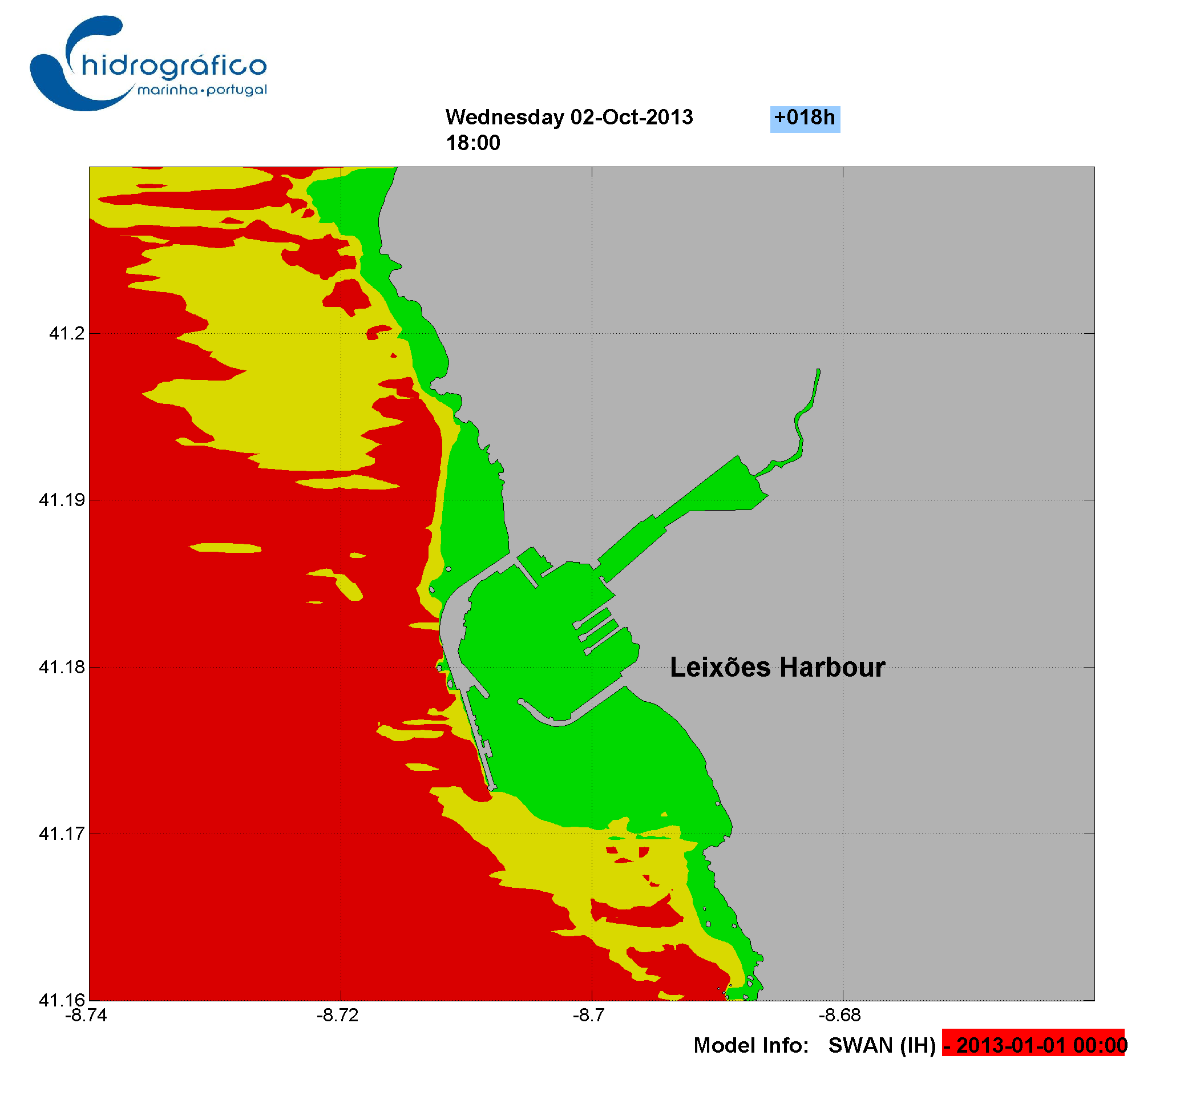
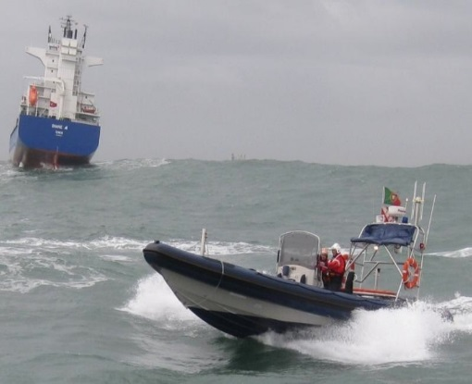
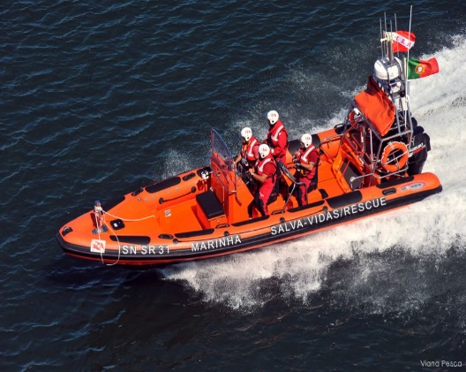
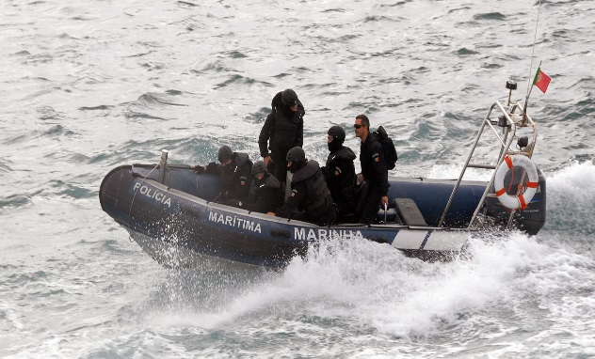
Mission Impact Diagrams
Harbour Pilots
SAR operations
SWAT
Scooping

Slide 15
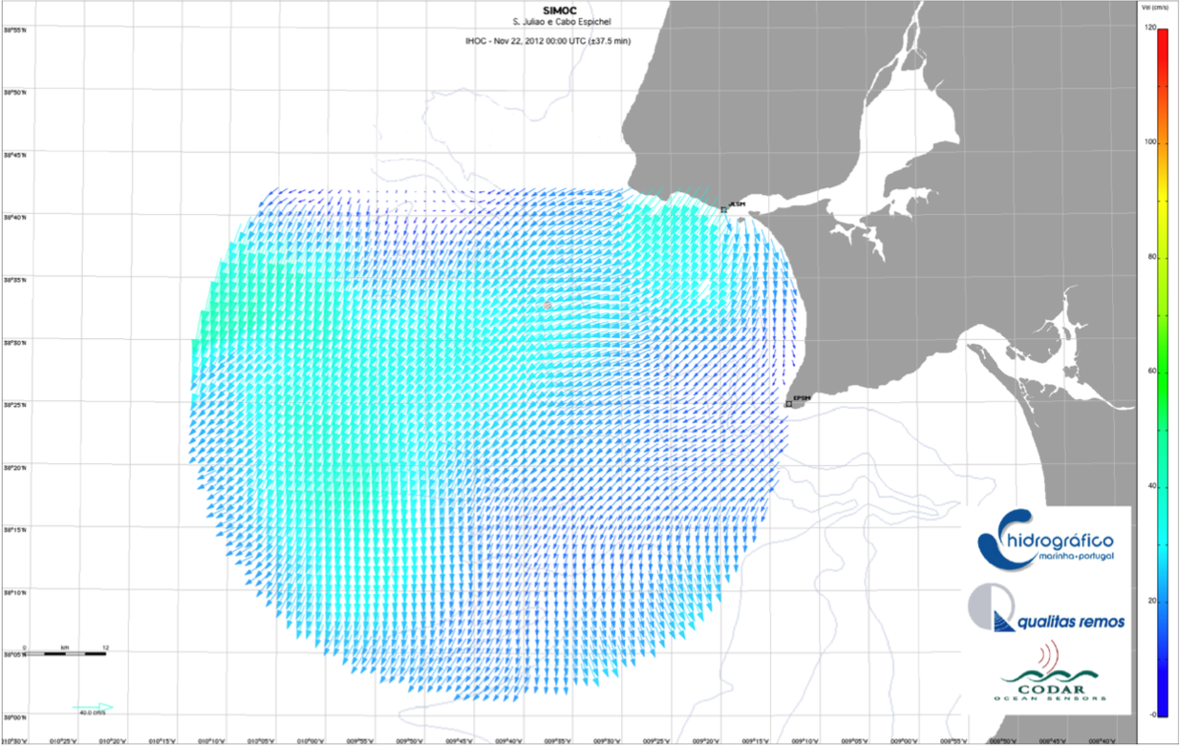
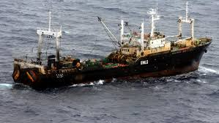
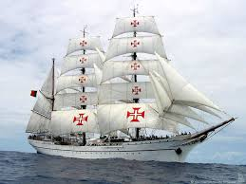
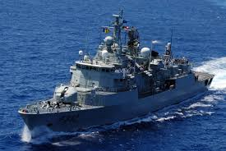
Safety and Security

Slide 16
CFR EH Carlos S. Fernandes

